Slide 1
Object Oriented Programming
Abeer GAUHER
Email: abeer.gauher@nu.edu.pk
Office: CS BASEMENT 2, Office number 23

Slide 2
Abstract Class
An abstract class is a class that has at least one pure virtual function (i.e., a function that has no definition).
The classes inheriting the abstract class must provide a definition for the pure virtual function; otherwise, the subclass would become an abstract class itself.
Abstract classes are essential to providing an abstraction to the code to make it reusable and extendable.
An abstract class is a class that is designed to be specifically used as a base class.

Slide 3
Abstract Class
For example, a Vehicle parent class with Truck and Motorbike inheriting from it is an abstraction that easily allows more vehicles to be added.
However, even though all vehicles have wheels, not all vehicles have the same number of wheels – this is where a pure virtual function is needed.

Slide 4
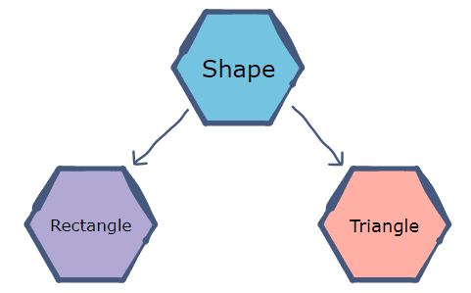
Abstract Class
Consider an example of a Shape base class with sub-classes (Triangle and Rectangle)​ that inherit the Shape class.

Slide 5
Abstract Class
Suppose we need a function to return the area of a shape.
The function will be declared in the Shape class; however, it cannot be defined there as the formula for the area is different for each shape.
A non-specific shape does not have an area, but rectangles and triangles do.
Therefore​, the pure virtual function for calculating​ area will be implemented differently by each sub-class.

Slide 6
Why to use pure VF?
Pure virtual functions are used
if a function doesn't have any use in the base class
but the function must be implemented by all its derived classes
A class that contains a pure virtual function is known as an abstract class.

Slide 7
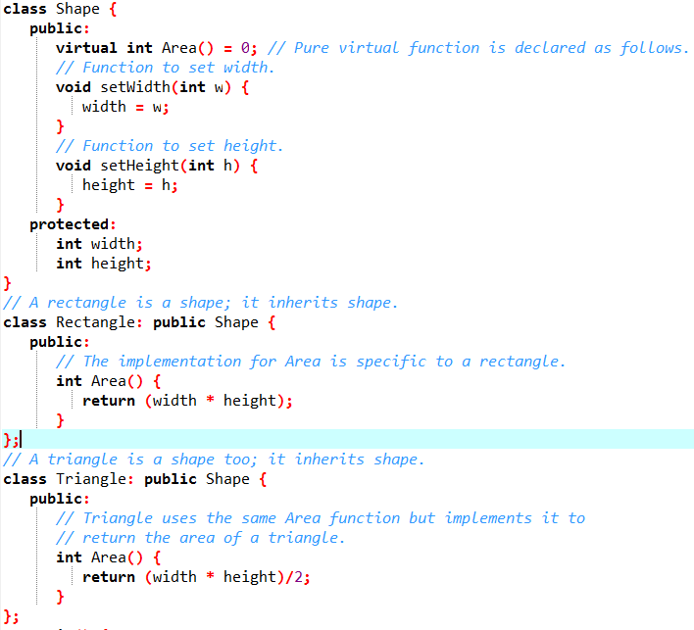
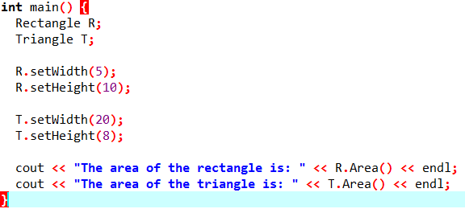

Abstract Class

Slide 8
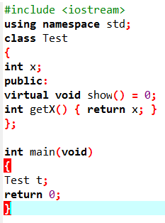

Abstract Class
FACTS:
A class is abstract if it has at least one pure virtual function.

Slide 9
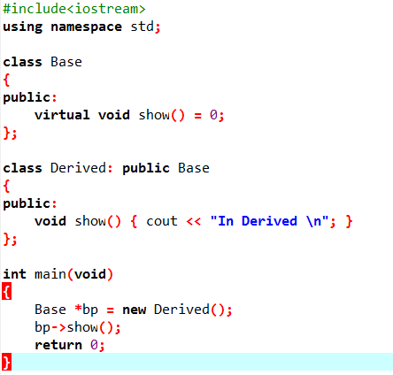
Abstract Class
FACTS:
We can have pointers and references of abstract class type.

Slide 10
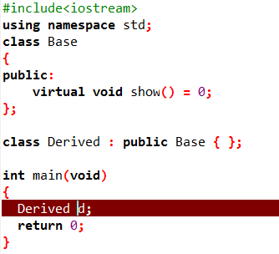
Abstract Class
FACTS:
If we do not override the pure virtual function in derived class, then derived class also becomes abstract class.

Slide 11
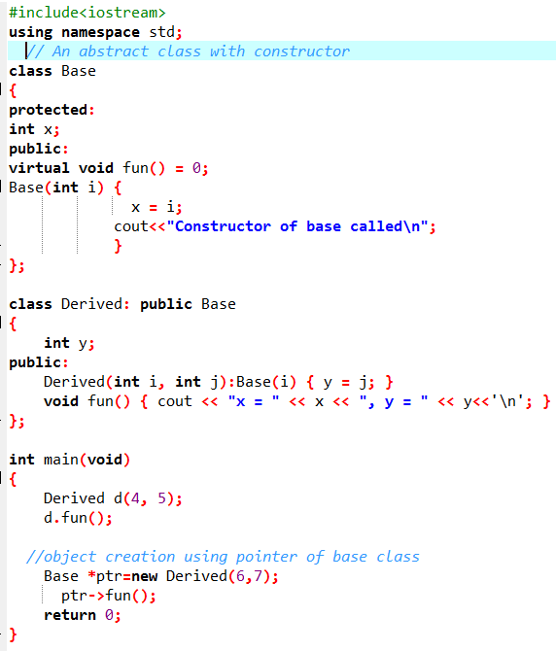

Abstract Class
FACTS:
An abstract class can have constructors.
We need to initialize the non-abstract methods and instance variables, therefore abstract classes have a constructors.

Slide 12
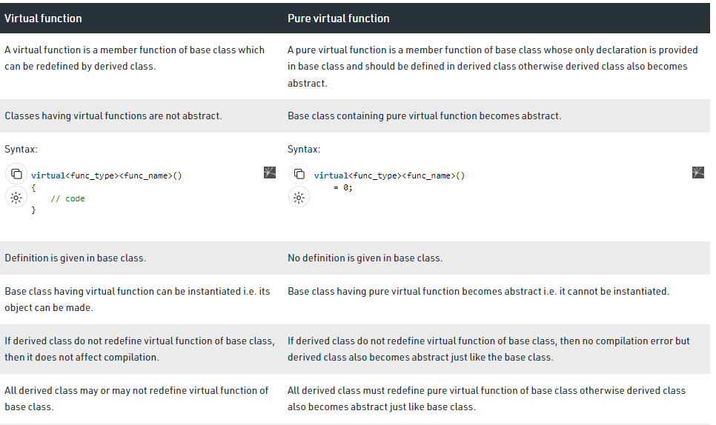
Abstract Class

